Slide 1
Corporate Nature and Classification
A corporation is a creature of statute, an artificial “person.”
Corporations can have one or more shareholders.
Owners can be natural persons or other businesses.
Corporation substitutes itself for shareholders.

Slide 2
Corporate Nature and Classification
Corporations are recognized as legal “persons” and enjoy many of the rights and privileges under our Constitution as natural persons.

Slide 3
Corporations
Characteristics of a Corporation
Legal existence
Unlimited duration
Free transferability of interest
Limited liability
Centralized management
Can hold legal title to property
Can sue and be sued

Slide 4
Corporate Nature and Classification
Corporate Personnel.
Responsibility for overall management of company rests with board of directors (elected by shareholders).
Board of directors makes policy decisions and hires officers to run corporation on a daily basis. →

Slide 5
Corporate Nature and Classification
Limited Liability of Shareholders.
One of the key advantages of corporations is the limited liability of shareholders
In certain situations, the corporate “veil” of limited liability can be pierced, holding the shareholders personally liable.

Slide 6
Corporate Nature and Classification
Corporate Earnings and Taxation.
Corporate profits can either be kept as retained earnings or passed on to the shareholders as dividends.
Corporate Taxation: corporate taxes can be taxes twice with C Corps, first to the corporation, then to the shareholders via dividends. →

Slide 7
Corporate Nature and Classification
Torts and Criminal Acts.
Corporation is liable for the torts committed by its agents or officers within the course and scope of their employment under the doctrine of respondeat superior. →

Slide 8
Corporate Nature and Classification
Torts and Criminal Acts.
Corporation can be liable for criminal acts via fines and/or license revocation.
Responsible officers may go to prison.

Slide 9
Piercing the Corporate Veil
In certain situations, courts will “pierce the corporate veil” and hold shareholders personally liable in the interests of justice and fairness. →

Slide 10
Corporate Liability
Reason for Piercing the Veil
No formalities—personal and corporate properties are mixed together
Ignoring corporate formalities - elections, meetings
Forming to perpetrate a fraud on creditors

Slide 11
Piercing the Corporate Veil
A Potential Problem for Closely Held Corporations.
Schultz v. General Electric Healthcare Financial Services (2010). Why was Schultz personally liable?

Slide 12
Corporate Liability
Liability Issues
Shareholders’ liability generally limited to amount of investment
If corporate veil is pierced, there is shareholder liability. Means corporate immunity from liability is set aside

Slide 13
Corporate Nature and Classification
Classification of Corporations.
Public (C-Corps) and Private Corporations.
Nonprofit Corporations.
B-Corps ) benefit corp)→

Slide 14
Corporate Nature and Classification
Classification of Corporations.
Closely Held Corporations.
Management of Closely Held Corporations.
Transfer of Shares
Shareholder Agreement to Restrict Stock.
Misappropriation of Closely Held Corporation Funds.
How would you determine reasonable compensation?

Slide 15
Corporate Nature and Classification
Classification of Corporations.
“S” Corporations: avoids federal tax under IRS Code “Subchapter S.”
Avoids federal “double taxation” of regular corporations at the corporate level. Only dividends are taxed to the shareholders as personal income. →

Slide 16
Corporate Nature and Classification
Classification of Corporations.
“S” Corporations: avoids federal tax under IRS Code “Subchapter S.”
IRS requirements: Corporation is domestic, fewer than 100 shareholders, only one class of stock, no shareholder can be a non-resident alien.
Professional Corporations.

Slide 17
Corporate Formation
Where to Incorporate
Status of state’s corporation laws
State tax laws
Ability to attract employees
Incentives

Slide 18
Corporate Formation
Must Comply With Statutory Requirements
File Articles of Incorporation:
Name
Names and addresses of all incorporators
Capital structure of the corporation
Types of stock

Slide 19
Corporate Formation and Powers
Incorporation Procedures.
Prepare the Articles of Incorporation: which deals with shares, the registered agent and office, incorporators, duration and purpose, and internal organization.
File the articles with the state.

Slide 20
Corporate Formation
Must Hold Initial Meeting After Incorporation
Elect new directors
Adopt bylaws (day-to-day procedures)
Issue Stock
Ratify Pre incorporation contracts

Slide 21
Corporate Directors
Election of Directors
Elected by shareholders to make corporate policy
May operate by committee
Hire officers of corporation and set officers’ salaries
Director Liability
Protected by the Business Judgment Rule. Directors and Officers must act in good forth and with prudence to avoid personal liability
Can consult experts but must study issues

Slide 22
Directors and Officers
Directors.
Election of Directors.
Generally, the number of directors is set forth in the articles of incorporation:
Directors appointed at the first organizational meeting. In closely held companies, directors are generally the incorporators and/or the shareholders.
Term of office varies )1-3 years. →

Slide 23
Directors and Officers
Directors.
Election of Directors.
Removal of Directors: directors can be removed for cause.
Vacancies on Board: if director dies or resigns or new position created by the articles or bylaws.

Slide 24
Directors and Officers
Directors.
Rights of Directors.
Participate in corporate decisions and inspect corporate books and records.
Compensation (usually a nominal sum). Corporation should guarantee reimbursement or purchase liability insurance to protect the board from personal liability.

Slide 25
Directors and Officers
Corporate Officers and Executives.
Officers serve at the pleasure of the Board of Directors but have fiduciary duties to company.
Their employment relationships are generally governed by contract law and employment law.
Officers may be terminated for cause.

Slide 26
Directors and Officers
Duties and Liabilities of Directors and Officers.
Directors and officers are fiduciaries and owe the company ethical and legal duties.
Duty of Care.
Duty to Make Informed Decisions. Directors are expected to be fully informed on corporate matters. →

Slide 27
Directors and Officers
Duties and Liabilities of Directors and Officers.
Business Judgment Rule: immunizes a director or officer from liability from bad decisions.
Court will not require directors or officers to manage “in hindsight.” BJR will apply as long as decision was reasonable, informed, made in good faith and best interests of the corp.

Slide 28
Corporate Liability
Officer Liability
Increasing personal liability
Increasing prosecutions
Particularly when environmental laws are violated

Slide 29
Directors and Officers
Duties and Liabilities of Directors and Officers.
Duty of Loyalty: subordination of personal interests to the welfare of the corporation.
No competition with Corporation.
No “corporate opportunity.”
No conflict of interests.
No insider trading. →

Slide 30
Directors and Officers
Duties and Liabilities of Directors and Officers.
Disclosure of Potential Conflicts of Interest.
Directors and officers must provide full disclosure of any potential conflicts of interest and abstain from voting on any transaction that may benefit the director/officer personally.
If reasonable, can be approved.

Slide 31
Shareholders
Shareholders generally have no right to manage the daily affairs of the corporation, but do so indirectly by electing directors.
Controlling shareholders owe a fiduciary duty to minority shareholders.

Slide 32
Shareholder Rights
Shareholders Have Right to Vote on Mergers, Consolidations, and Sale of All Assets, Not on Acquisition
Procedure
Board of Directors adopts resolution in favor of combination or sale
Resolution with notice of meeting sent to all shareholders
Shareholders vote on resolution at meeting

Slide 33
Shareholders
Shareholders’ Meetings.
Must occur at least annually. Voting requirements and procedures are:
Notice of Meetings.
Proxies.
Shareholder Proposals.

Slide 34
Shareholders
Shareholders’ Meetings.
Shareholder Voting.
Quorum Requirements: shareholders representing more than 50% of shares must be present to conduct business.
Voting Lists: record of stock ownership. →

Slide 35
Shareholder Rights
Shareholders Have Access to Books and Records
Under revised MBCA, no ownership requirements
Must have proper purpose
Generally Shares in a Corporation are Freely Transferable; However Sometimes Transfers are Restricted

Slide 36
Shareholders
Rights of Shareholders.
Dividends: distribution of corporate profits or income ordered by the board.
Directors’ Failure to Declare a Dividend.
Inspection Rights.
Transfer of Shares. →

Slide 37
Shareholders
Duties and Liabilities of Shareholders.
Shareholders are generally not liable for the contracts or torts of the corporation.
If the corporation fails, shareholders generally cannot lose more than their investment. →

Slide 38
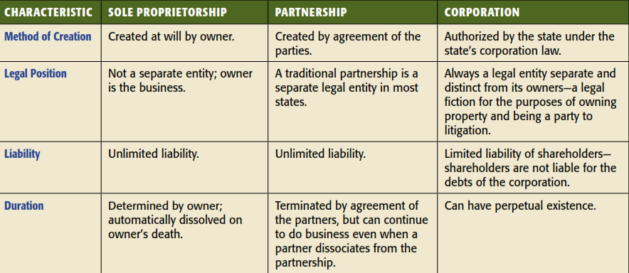
Major Business Forms Compared

Slide 39
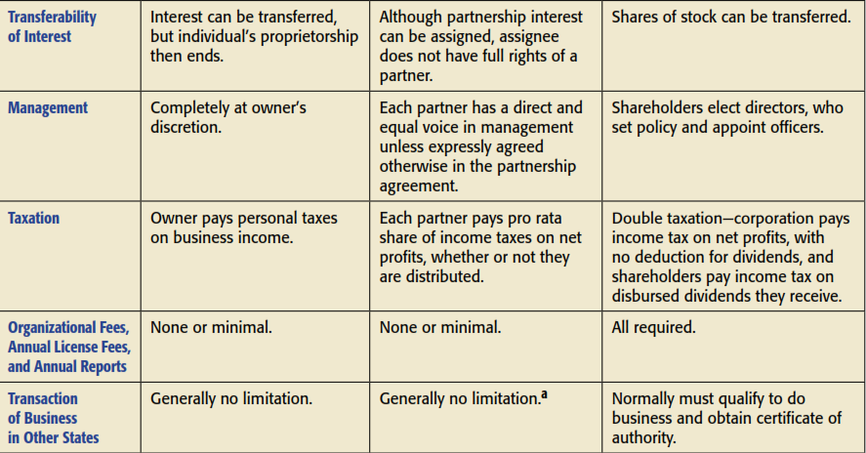
Major Business Forms Compared

